Slide 1
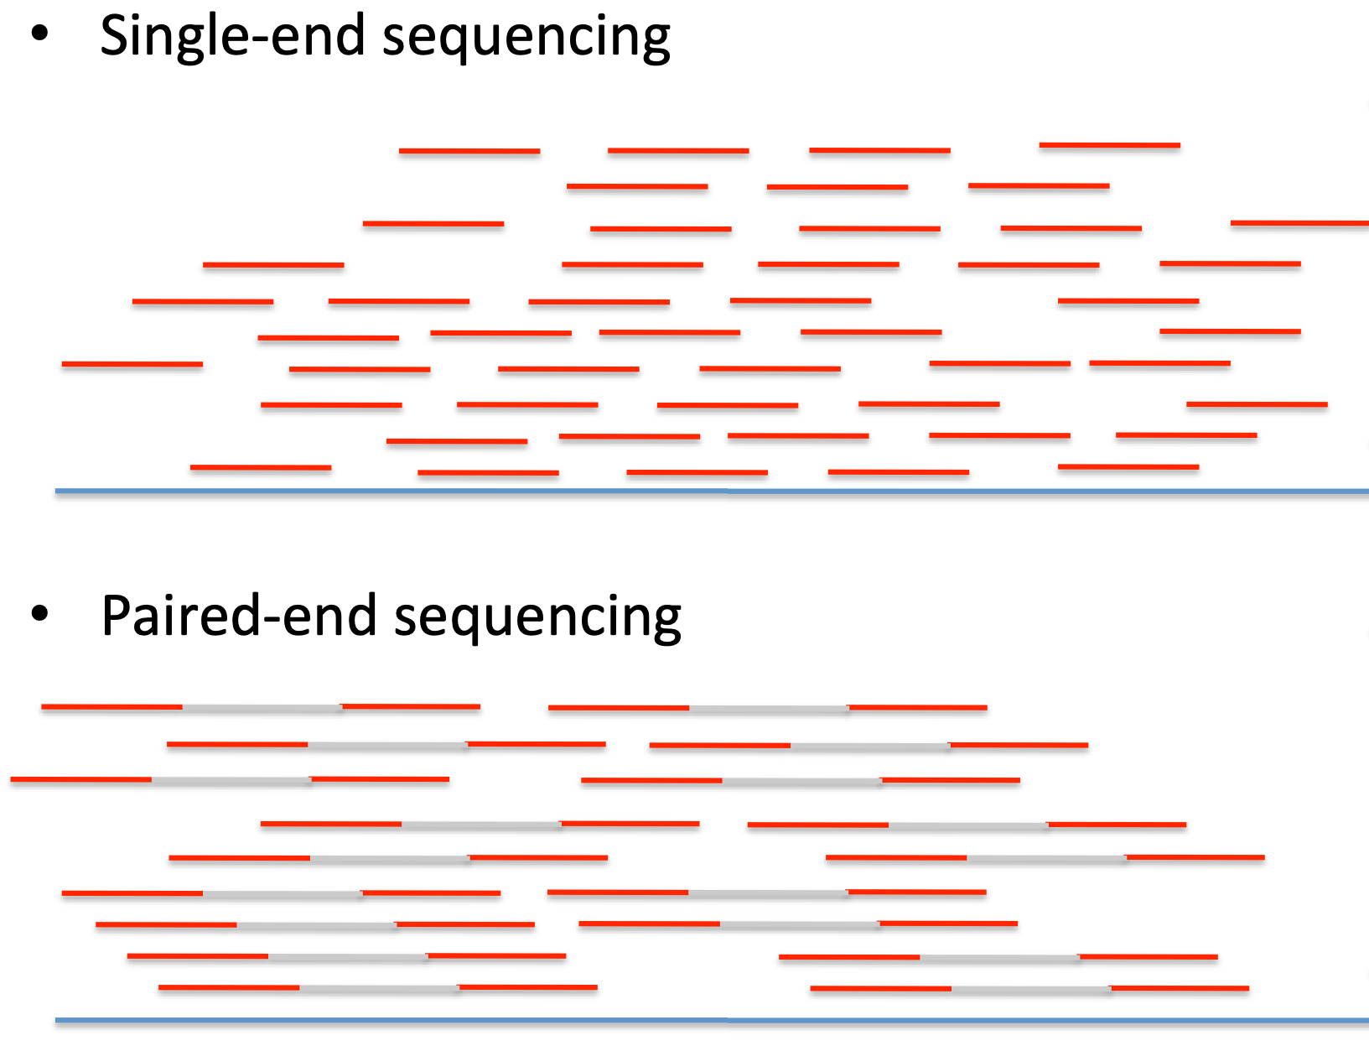

Slide 2
Shotgun Sequencing: Problemi di Assemblaggio

Slide 3
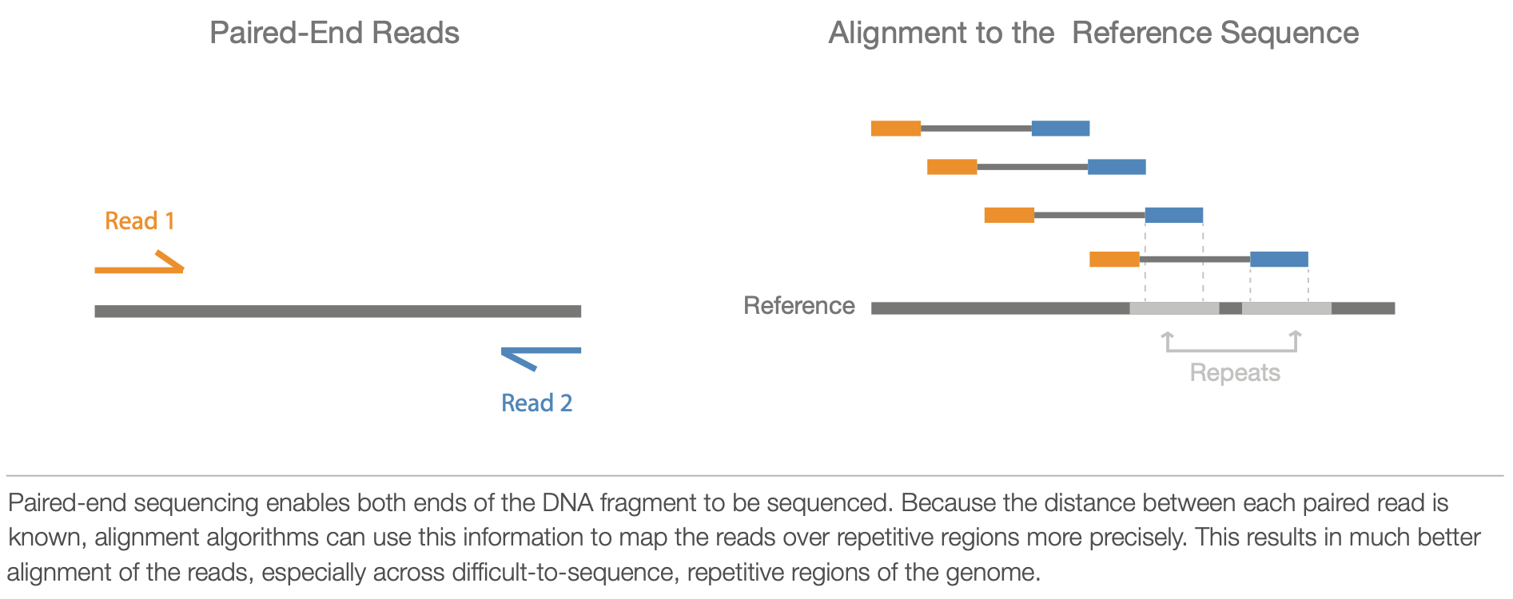
Paired-End Sequencing

Slide 4
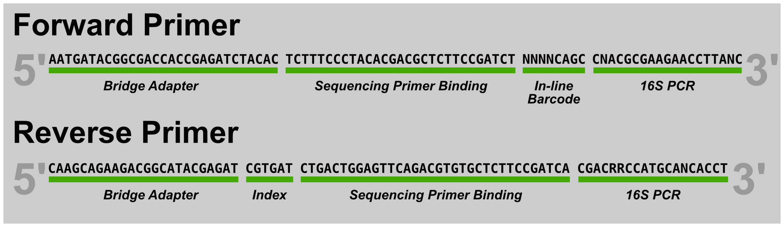
Multiplexing

